Slide 1
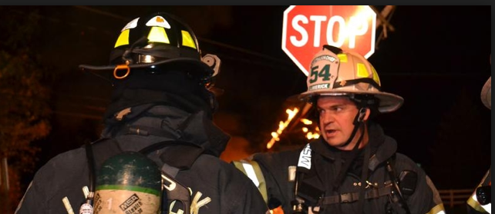
Communication
Message
Receiver
Sender
Feedback
in the Fire/EMS Service

Slide 2
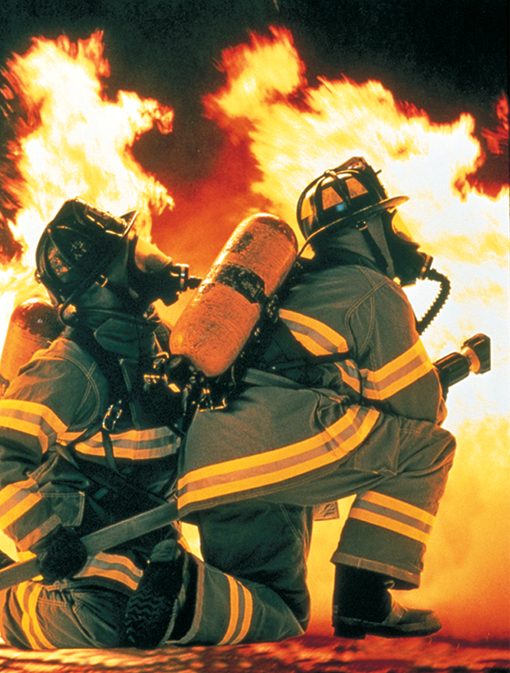
Can you handle the heat?

Slide 3
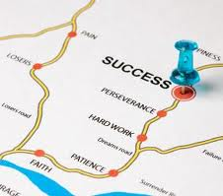
Roadmap
Why do you want to join
What communication is
Factors impacting communication
Moving Forward
Notes:
Why do you want to join…what are your expectations vs. reality
What communication is
Organizational culture
Factors impacting communication
Moving Forward

Slide 4
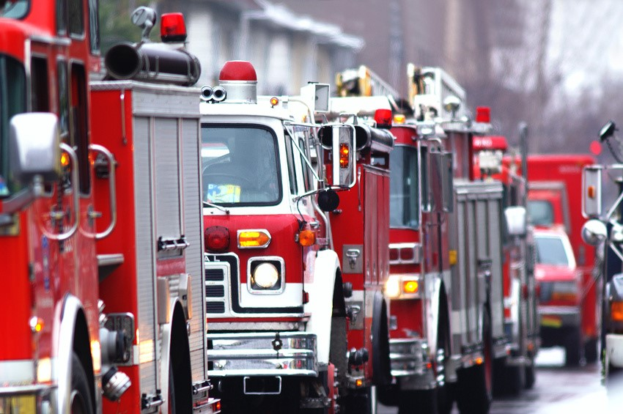
What brought you here?
Cool trucks with lights and sirens
Adrenaline rush
I want to save lives
Self-actualization
Notes:
Let’s talk a little bit about why you are here
what drives you…what are you hoping to accomplish?
There are many and varied reasons for joining. Lets examine some of these
Cool toys with flashy things and loud noises‘
I love speed, emergency situations, pressure, OMG, I love when things go wrong, I want to be like Johnny and Roy, those guys on Chicago fire, I want to save lives,
I sense a higher purpose in life, Maslow's, hierarchy, some of you may not be familier with this so let me explain….. However quite a few of you are at level 4, self-esteem where you strive for self respect and respect of others, To have achieved self-actualization, in order to achieve the 5th level, self actualization, one must have acceptance of self and others, and be able to see things as they are, not as you wish. You learn to do the right thing.
Savings lives is rare, think about the statistics, (explain)
We do much more, we are many things to the patients we encounter, and always remember why you are here to serve the community, we will help you achieve your 5th level.
I want to be an EMT, doctor, nurse, physical therapist

Slide 5
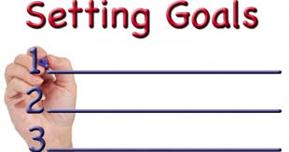
Personal Goals
Personal goals
School
Career
Family
Friends
Notes:
My friend is doing it and they say its cool, What's cool about it?
We all set goals for ourselves in many areas of our lives, some are doing this for SSL, looking for a path to a career, some are legacy members, generations of family being members. It looks good on a medical school application, for some its what your friends are doing. regardless of the goals you set and your rationale.
meet people, learn a skill, what are the realities of your expectations. and most importantly strategies on how to succeed, learn the craft, and not let yourself fail. There are days worth of this topic which I will cover in an hour

Slide 6
The part you don’t hear…
Notes:
There are things to consider when attempting to reach them, how you go about achieving these is dependent on you and your environment you will be in, how you communicate, learn, speak will go a long way to your success, being a member of a dept. means many things and they are not always positive, there will be times that will try you, and test you, older members who will treat you indifferently and do things that border of college frat antics. The county is not intolerant of such things and nether should you.
Communication: its critical in the fire service, and and as you just learned, its critical to the success of the dept., you and the community. You just learned valuable tips on how to listen and learn. In these days of the X, Y, Z generation, and the millennial. Expectations are so much different then they were even thirty years ago. Some of you have the expectation that you will come in and tear the walls down and pretend you are storming the beach's of Normandy and guess what, you wont. As Brenda mentioned earlier. You have to deal with many type-A’s. so 'listen to these few tips on succeeding and making it past your first year.
Time Management: Keep a planner, track things make time for whats important and prioritize. In doing this you make sacrifices, you know that already. Sometimes the sacrifice is yourself, don’t let it be, save time for whats important.
Listen: you don’t know anything and no amount of book learning is going to change that. This is one arena where experience does count, and as a rookie, you have little to offer, so don’t try
Learn: listen to conversations, learn from the old timers, volunteer for details, learn your area, learn your community, and get to know the culture
Train: nothing will go further than your ability to learn and train like attending classes. Attending classes either through the PSTA, MFRI, or any of the myriad of federal programs like TEEX, CDP will go along way to achieving training objectives and rank.
Drilling: as important as training is, drilling is more critical. You can attain all the levels of certification you want, but if you don’t train on them and practice your skill craft, you have attained nothing. Lots of folks spend inordinate amounts of time in training, but never practice what they have learned. Its better to have perfected a small craft and become an expert on it vs.. being a generalist.
Tell story about cut finger on cat food can at 3:AM and whats women was going through.

Slide 7
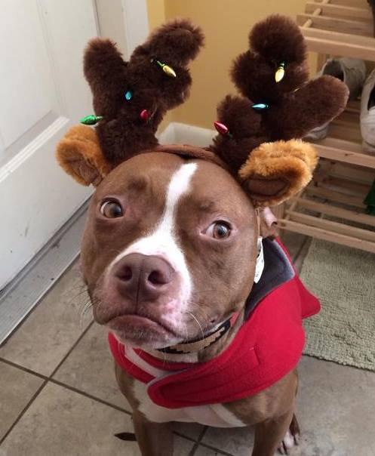
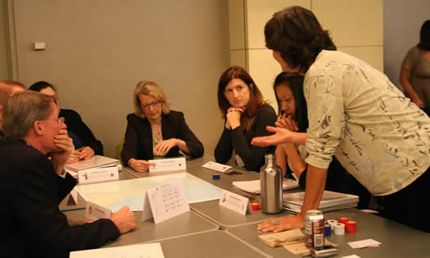
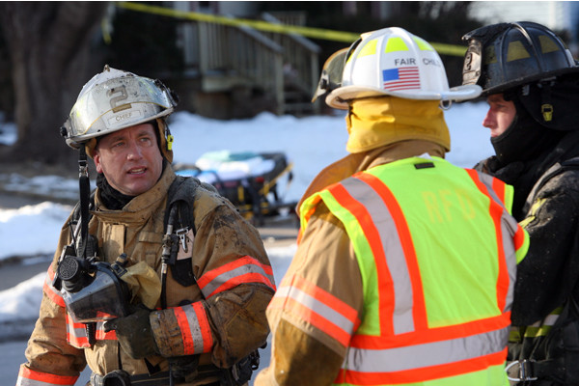
What is Communication?
Continuous cllaborative process of verbal and non-verbal meaning making
Taken for granted
No one person is in total control
Contains many elements
Notes:
Communication
the continuous collaborative process of verbal and nonverbal meaning-making
Why can it be difficult sometimes?
Take it for granted
forget 50 percent of what you hear immediately
75 percent by the next day.
Since it is collaborative, no one person can totally control the experience
Contains many elements or dimensions
tone of voice, choice of words, past history, social roles, religious beliefs, ethnicity, and of course facial expressions

Slide 8
Factors impacting communication
Generational differences
Cultural differences
Fire/EMS specific issues
Notes:
Why I’ve always done it this way and always will
Who are all of these forieners
Fire vs EMS, I didn’t sign up to ride no amboolance

Slide 9
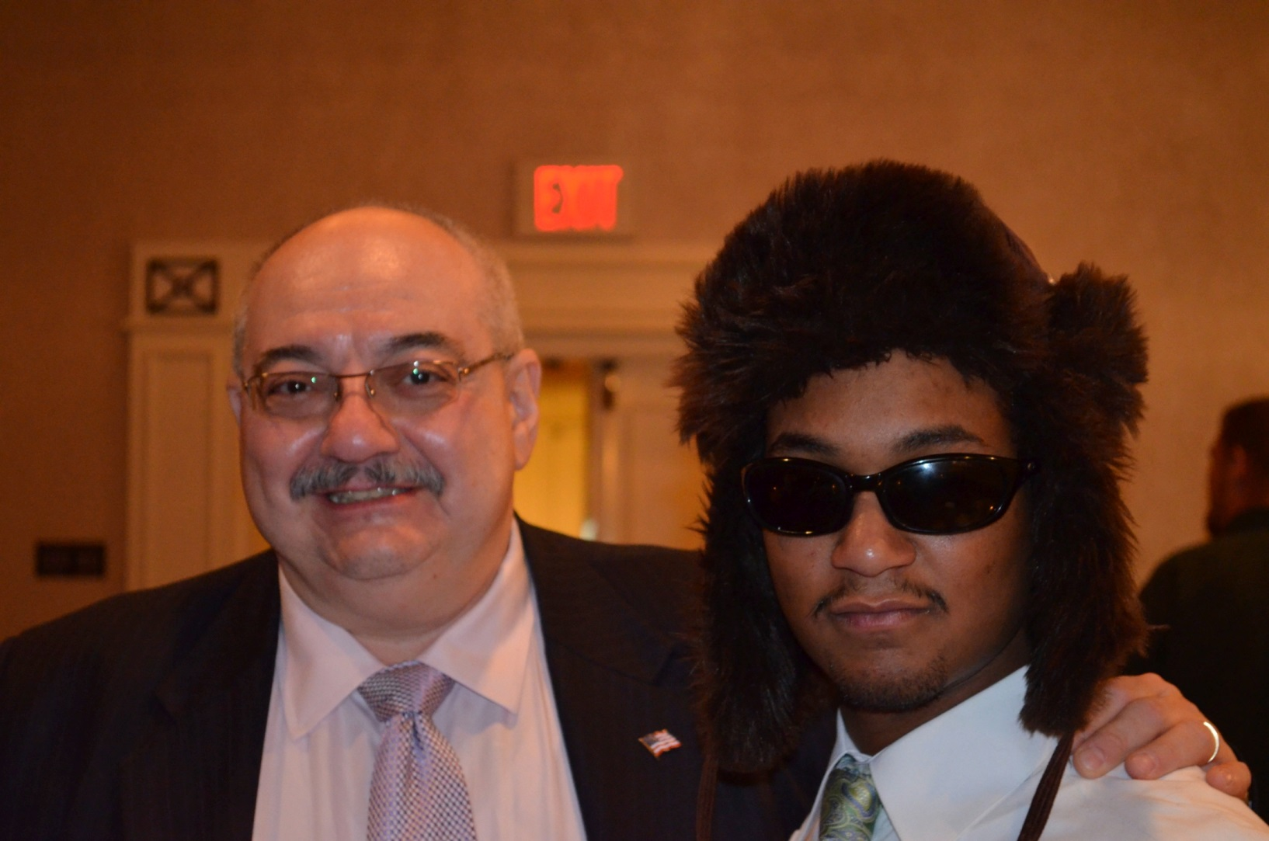
Generational differences
Traditionals (1922-1945)
69-92
Babyboomers (1946-1965)
49-68
Generation X (1966-1979)
35-48
Generation Y -- Millennials (1980-1999)
15-34
Notes:
Paying attention to generational differences in the workplace are important
influenced by its period's
Economic
political
social environment
Generational differences
Can cause clashes in the workplace
Can also create value

Slide 10
Traditionals’ attitude toward…
Work | Hard-working; process oriented
Employer | Most loyal workers (70% wants to stay)
Authority | Value conformity and rules; top-down management approach
Supervision | May be insulted by continuous feedback
Respect | Want opinions to be given more weight; expects deference based on experience
Notes:
Disclaimer: These are “characterizations” of certain age groups and may lend itself to “stereotypes” Some actual research does not support these labels.

Slide 11
Baby Boomers’ attitude toward…
Work | Workaholics; process oriented
Employer | Value commitment and loyalty (65% want to stay)
Authority | May be uncomfortable interacting with authority figures
Supervision | May be insulted by continuous feedback
Respect | Want opinions to be given more weight; expects deference based on experience

Slide 12
Generation X’s attitude toward…
Work | Only work as hard as needed; results oriented
Employer | Loyal to people more than company (40% want to stay)
Authority | Comfortable interacting with authorities; not impressed or intimidated by titles
Supervision | Immediate and continuous
Respect | Want to be held in esteem and listened to; do not expect deference
Notes:
X’ers and Millennials learned that loyalty to an employer did not guarantee job security from witnessing job losses among parents who were loyal to their employers and played by the rules.

Slide 13
Millennials’ attitude toward…
Work | Work only as hard as needed; results oriented
Employer | Loyal when dedicated to an idea, cause or product (20% want to stay)
Authority | Believe respect must be earned regardless of level or title
Supervision | Immediate and continuous
Respect | Want to be held in esteem and listened to; do not expect deference
Notes:
Regardless of generation, employees tended to stay if their company’s values matched their own

Slide 14
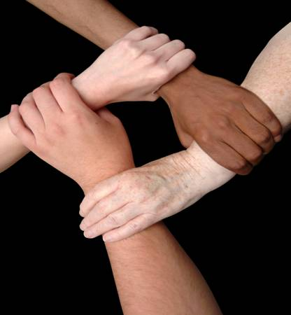
Cultural differences
High-context
Message is understood through context
Time is synchronous
Group harmony important
Dislike direct confrontation
Low-context
Messages should be specific
Time is chronological/sequential
Individual rights supersede blind duty to family
Conflict is a natural part of life

Slide 15
Organizational Culture
Fire/EMS
Tasks
Goals
Obj.
Attitudes
Service
Personalities
Notes:
Each organization is different,
There is potential for
conflict and destructiveness,
Creativity and accomplishment
Culture
shared values and beliefs people hold

Slide 16
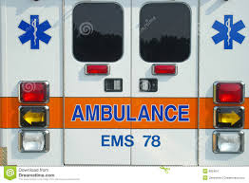
The Problem in the Fire/EMS Service…
Para-military culture
“Grape-vine” realities
Morale/work issues
Loss of sense of purpose…why we are here
Notes:
Para-military structure
Hierarchical structure that clearly emphasizes adherence to principal structure over flexibility
Need to understand the communication style of the leaders ahead of time…an active incident scene is no time to be asking what is or how to
Without effective and accurate communication, the grapevine becomes the “source of truth”
People in organizations for awhile can inadvertently cue new employees how to maintain the “status quo” they have created and that they are comfortable with, even if it’s not the best for the department
Poor communication results in poor morale and incomplete work assignments
Leads to unmet goals/objectives
Public scrutiny
Dangerous “work environment”
Some nights, we are busy from the beginning of the shift to the end…other nights not so much
This combined with the banter that can happen during the down time can lead to us getting wrapped up in the drama and forgetting why we are really here

Slide 17
Dialogue inside of the walls
Treat others as you would want to be treated
Smile…whether you feel like it or not
Presentation is everything
Think before you speak
Stand by your beliefs
It’s not us vs. them
Notes:
Where to start
As simple as some of the guidelines are that I have given you, there are some basic tenants of life we should always keep in mind
Treat others as you would want to be treated, not as others say you should treat them. i.e. don’t judge career personnel on basis of hat others say, but on what your experience is, bring cold and distant will only reinforce the stereotype of the career vs. volunteer rift which exists.
Smile, it takes 54 facial muscles to frown, and only three to smile.
Remember that no matter how you feel, you are generally taking care of people on the worst day of their lives, don’t make your problems theirs as well, cite 2:00 PM story
Presentation is everything as well as first appearances, be professional in your doings, look professional, be professional, act professional
Think before you speak, don’t answer angrily, think about the repercussions of your actions and beyond the first ripple.
Stand by your beliefs and morale center. If you know its right stand by those beliefs
Its not us vs them, we are all here for one reason , what is it.
Serve the community, if that’s not your overriding belief, theres the door

Slide 18
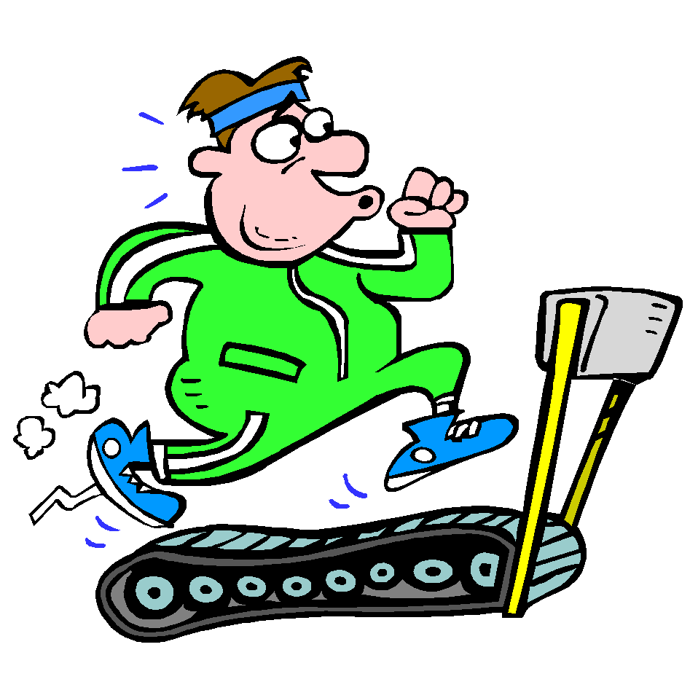
Moving Forward
What communication should be
Effective listening
Conflict resolution
Social media

Slide 19
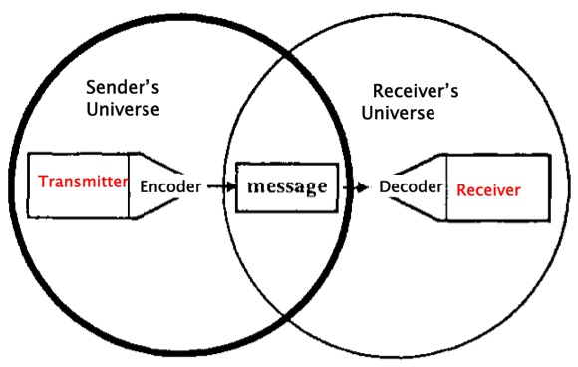
Effective Communication
Notes:
Enhanced communication skills
When you learn how to give and get criticism gracefully, to manage conflicts effectively and to develop relationships smoothly

Slide 20
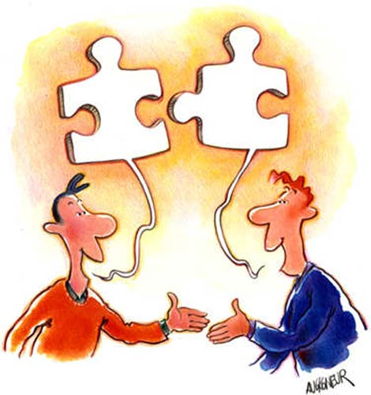
Moving toward dialogue
Communication is a two-way street
Give up the concept of “fault”
Importance of ordinary conversation
Notes:
Communication must be created based on receiver…not just the sender
Accurately presented
Accurately received/interpreted
Ask for clarification if and when necessary
Don’t be vague with message; be specific in what you are saying
Get rid of the concept of “fault”
Communication is collaborative
If the direction giver gave confusing information, did the received ask about what confused him?
Everyone is response-able
Have the willingness and ability to contribute in some way to how things are unfolding
Ordinary conversation
The single greatest learning tool in your organization
Important to pay close attention to the common and everyday conversations

Slide 21
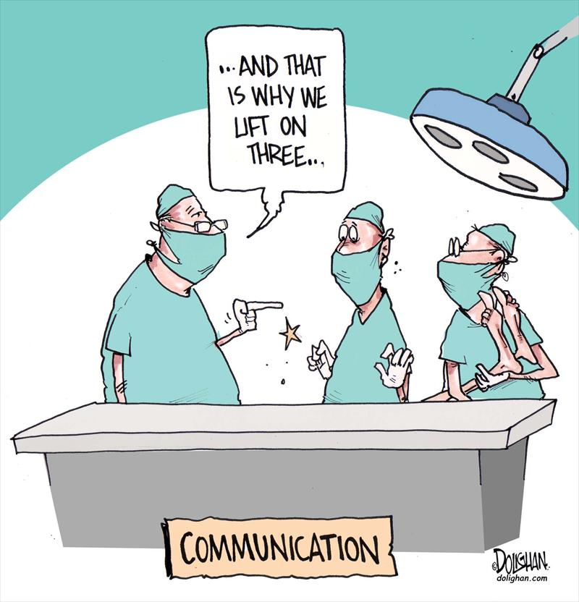
Effective Listening
Notes:
Few people see improving listening as a way to improving communicating.
barriers to effective listening
We speak about 180 words a minute, but listen at about 300 to 500 words a minute…this difference causes the listener to lose focus.
Listening for any length of time is exhausting.
Stereotyping causes us to hear what we expect rather than what another person actually says.
Your past experiences can color the way you look at life.
developing listening skills
Don’t interrupt speaker
we usually interrupt, because we
lack value in what they say
desire to impress with our knowledge
Are too excited to let them finish.

Slide 22
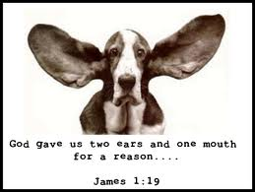
Effective Listening
Make listening our FIRST priority
Do not interrupt
Check your emotions and suspend judgment
Ask questions for clarity
Notes:
Check your emotions and suspend your judgment until you hear the entire story.
Ask questions for clarity
we should always make listening our first priority
Many people take for granted the ability to listen, but few are really capable of really listening
James 1:19 – My dear brothers and sisters, take note of this: Everyone should be quick to listen and slow to speak, and slow to anger.

Slide 23
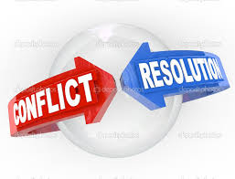
Conflict Resolution
Objectives
Solve the problem at hand
Maintain the relationship
How to achieve
Listen first
Assume positive intent
Choose your battles
Tailor your response to fit the recipients’ style
Notes:
Ensure you are bringing a level of humanity to the table
As a human, you have the ability to respond and not simply react
No matter how toxic a pattern of communication two groups are caught in, the next move could be positive
Become creative instead of retaliatory – not always part of the current culture, but we can work on getting it there

Slide 24
Notes:
Is it okay to use social media for fire/ems service activities?
Yes and no!
The Good
It is certainly okay to let your friends and family know you are a volunteer with the Montgomery County Fire and EMS Services
May encourage others to volunteer their time to this important endeavor
You are doing something good for your community
You deserve to be proud of this
The Bad
Its permanent
What you do now may come back and haunt you 30 years later

Slide 25
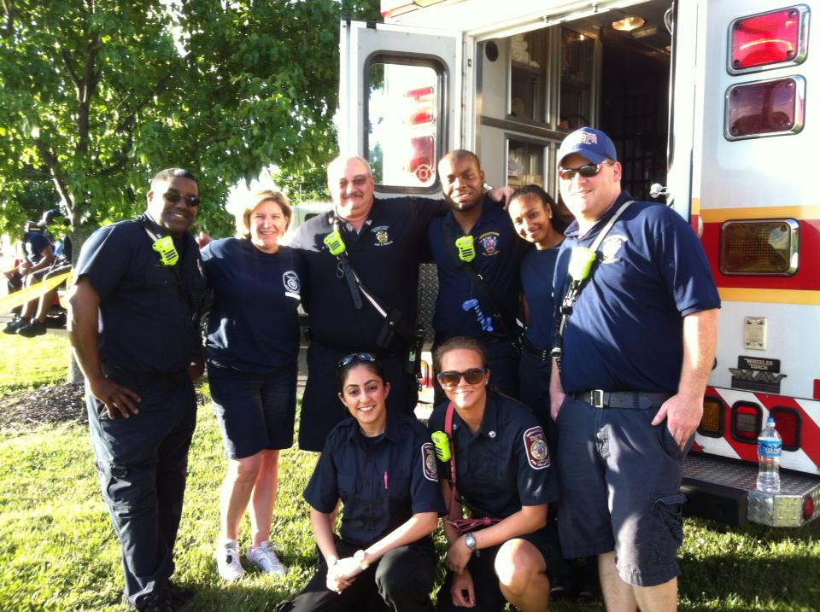
What is acceptable?
Notes:
What is acceptable?
Perhaps a picture of you with your fellow department members in front of a piece of apparatus
Maybe at an event or an open house
Unfortunately, we may not always think before we post…
That leads us to the bad…

Slide 26
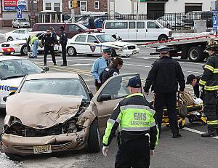
What is not acceptable?
Notes:
What is not acceptable?
Any photo with potentially identifying information is clearly not acceptable
A license plate
A house number
A face
What is your purpose for being in that location?
I won’t even go into the ugly…I googled it and was too disgusted at some of the images people were posting…

Slide 27
Bringing it all together…
Notes:
Remember…you don’t have to be a Chief to be a Leader
In essence, you can look at this experience similar to joining a fraternity, or a social group if you will
A lot is asked of you in the first year
This will help prepare you to become a full member of the brotherhood
Important to keep in mind you are going to be dealing with
People who have been here awhile…prior to good communication skills being seen as necessary
Possibly some “Type-A” personalities (what does the A really stand for?)
You can be the conduit to a better environment going forward in terms of communication using these strategies

Slide 28
It’s the little things in life…
http://youtu.be/sAQfzHBpRsc

